Slide 1


Toronto Police
Major Crime Indicators (MCI)
SCS 3253-061 – Machine Learning
Instructor: Saeid Abolfazli
Team members:
Caio Gasparine | Fábio Queiroz | Olivier Sangam | Illidan Yuan
https://github.com/caiogasparine/SCS_3253_061-Machine-Learning
April 2023

Slide 2

INTRO / BACKGROUND
Toronto Police
Source of Data: Major Crime Indicators (MCI) Historical
This dataset includes all Major Crime Indicators (MCI) occurrences by reported date and related offences from 2014 to June 30, 2022.
https://data.torontopolice.on.ca/

Slide 3
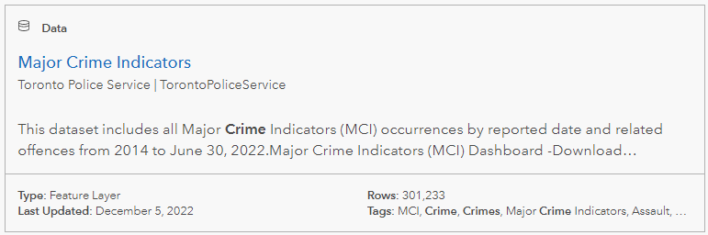
INTRO / BACKGROUND
https://data.torontopolice.on.ca/pages/major-crime-indicators
Toronto Police

Slide 4
INTRO / BACKGROUND
This dataset includes all Major Crime Indicators (MCI) occurrences by reported date and related offences. The MCI categories include Assault, Break and Enter, Auto Theft, Robbery, and Theft Over. This data is provided at the offence and/or victim level, therefore one occurrence number may have several records associated with the various MCIs used to categorize the occurrence. This data does not include occurrences that have been deemed unfounded. The definition of unfounded according to Statistics Canada is: “It has been determined through police investigation that the offence reported did not occur, nor was it attempted” (Statistics Canada, 2020).4
Format: CSV, XML, SHP
https://data.torontopolice.on.ca/datasets/TorontoPS::major-crime-indicators-1/about

Slide 5
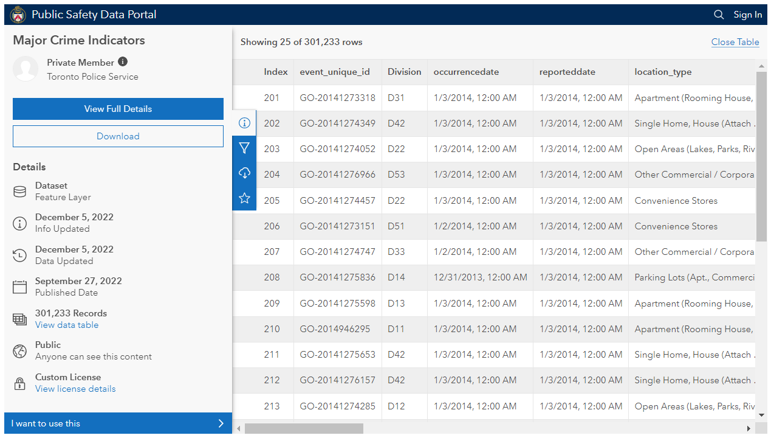
INTRO / BACKGROUND

Slide 6

PROBLEM STATEMENT
The Problem
Crime rates are skyrocketing very fast in Toronto and two main challenges are part of this situation:
(1) identify what would be the probability of a new occurrence considering your geolocation, based on the number of occurrences in certain location.
(2) determine where would be the optimized location (clusters) for new police patrol based on the current crime rates and location.

Slide 7
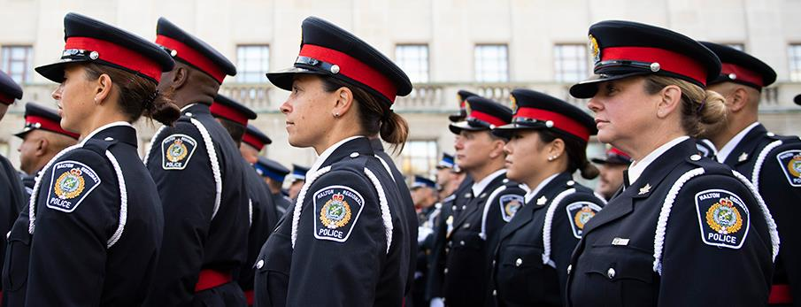
PROBLEM STATEMENT
Solution Scope
Develop a solution to address the problem (1) and (2) and give possible alternatives to the problem, based on the historical data analysis.

Slide 8

PROBLEM STATEMENT
Assumptions
Consider only years with a complete set of data (2014 – 2021).
The occurrence date (day, month, year) of the events will the major driver for all the evaluations.
Explore visuals solutions to facilitate the data interpretability.
Real Time OR Near Real-Time Solution.
The enterprise solution architecture must consider automatic data ingestion (and be prepared to scale in an RT/NRT data scenario).
Complete solution (End-2-End), considering the ML model and training + enterprise cloud architecture for future implementation.
Utilization of the current Microsoft Azure infra.

Slide 9

METHODOLOGY
Methodology
Big picture / Frame the problem
Get the data / develop the pipeline
Explore and visualize the data to gain insights
Prepare the data for the ML algorithm
Select a model and train it
Fine-tune your model
Present your solution
Launch, monitor, and maintain your system (MLOps)

Slide 10
1. Big picture / Frame the problem
METHODOLOGY
identify what would be the probability of a new occurrence considering your geolocation.
Fields available:
Long + Lat
Location Type
Premises Type
Hood_ID
Neighborhood
(2) determine where would be the optimized location (clusters) for new police patrols based on the current crime rates and location. > Same fields + number of occurrences and critically

Slide 11
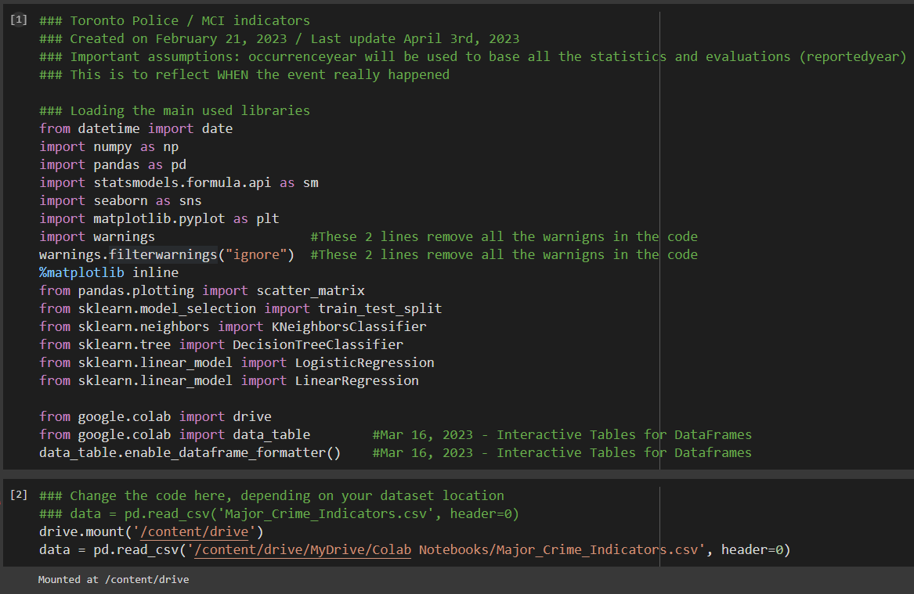
2. Get the data / develop the pipeline
METHODOLOGY

Slide 12
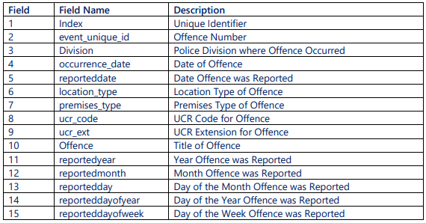
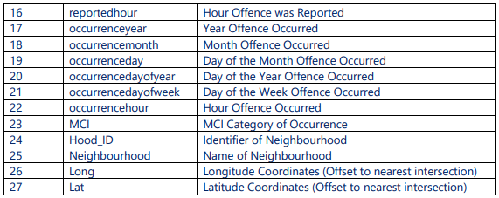
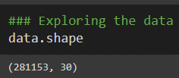
2.1 Data Description
METHODOLOGY
This dataset includes all Major Crime Indicators (MCI) occurrences by reported date and related offences. The MCI categories include Assault, Break and Enter, Auto Theft, Robbery, and Theft Over. This data is provided at the offence and/or victim level, therefore one occurrence number may have several records associated with the various MCIs used to categorize the occurrence. This data does not include occurrences that have been deemed unfounded. The definition of unfounded according to Statistics Canada is: “It has been determined through police investigation that the offence reported did not occur, nor was it attempted” (Statistics Canada, 2020).4
Format: CSV, XML, SHP

Slide 13
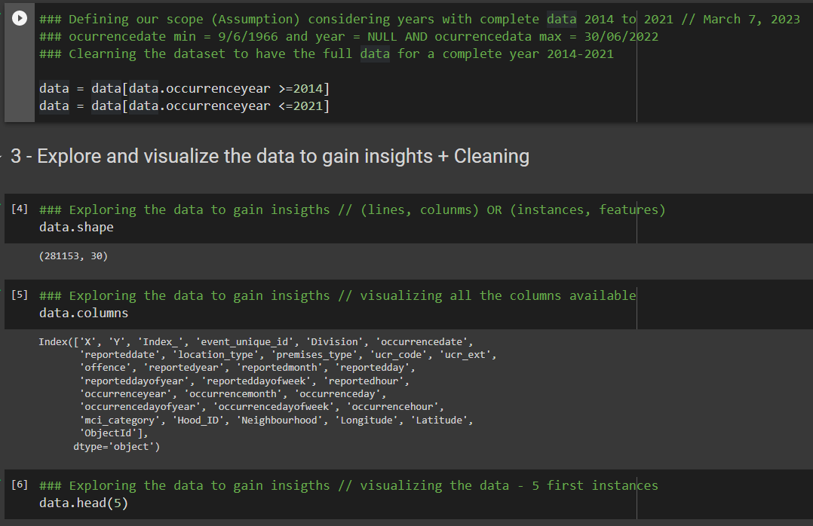
3. Explore and visualize the data to gain insights
METHODOLOGY

Slide 14
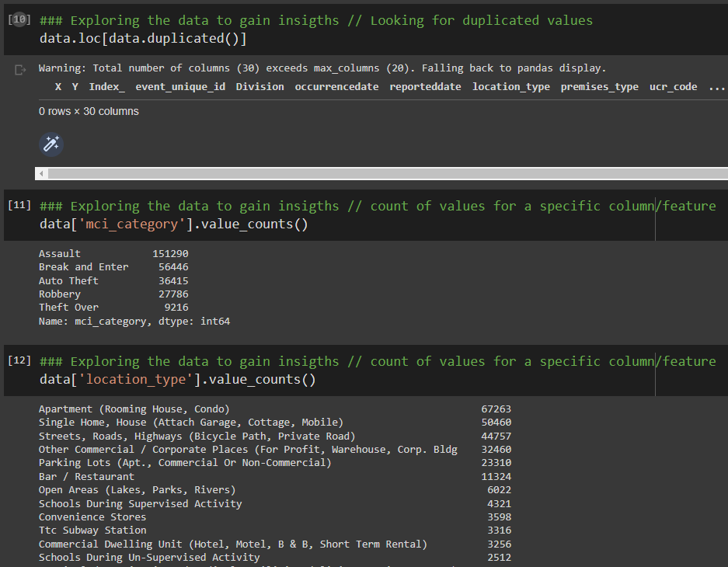
3. Explore and visualize the data to gain insights
METHODOLOGY

Slide 15
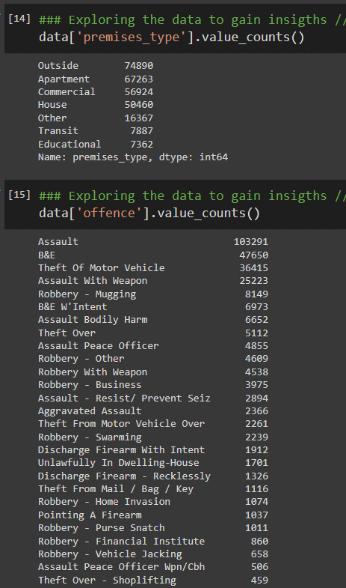
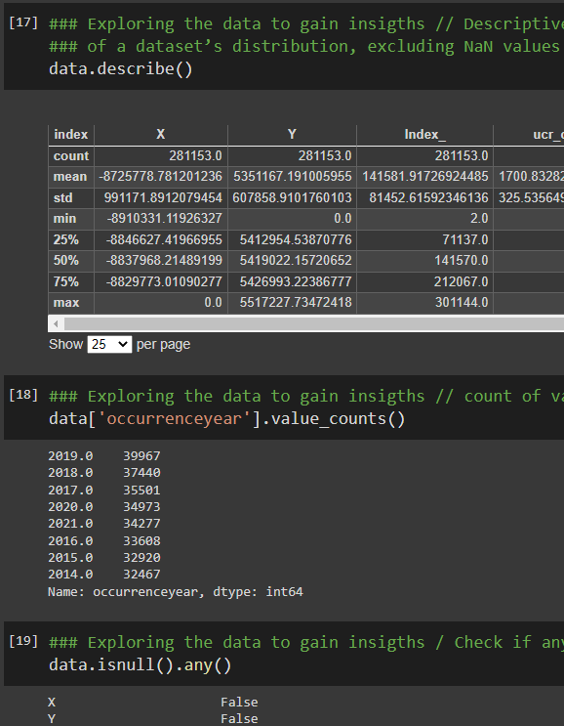
3. Explore and visualize the data to gain insights
METHODOLOGY

Slide 16
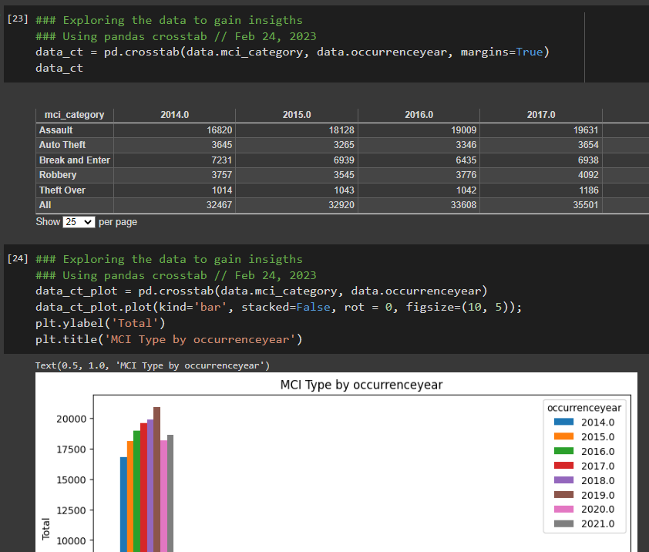
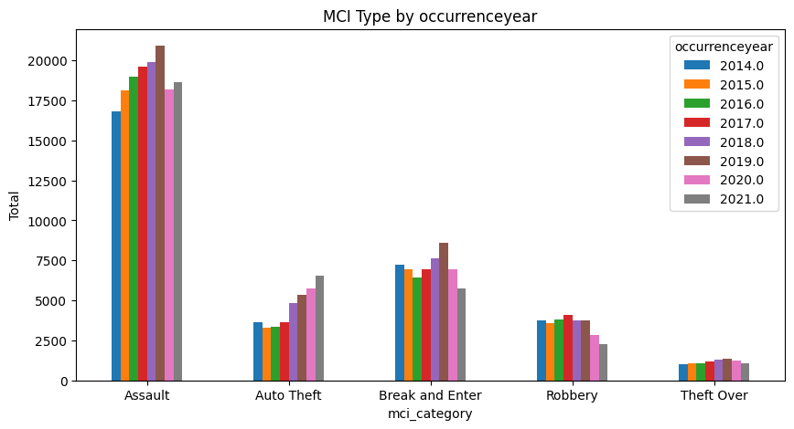
3. Explore and visualize the data to gain insights
METHODOLOGY

Slide 17
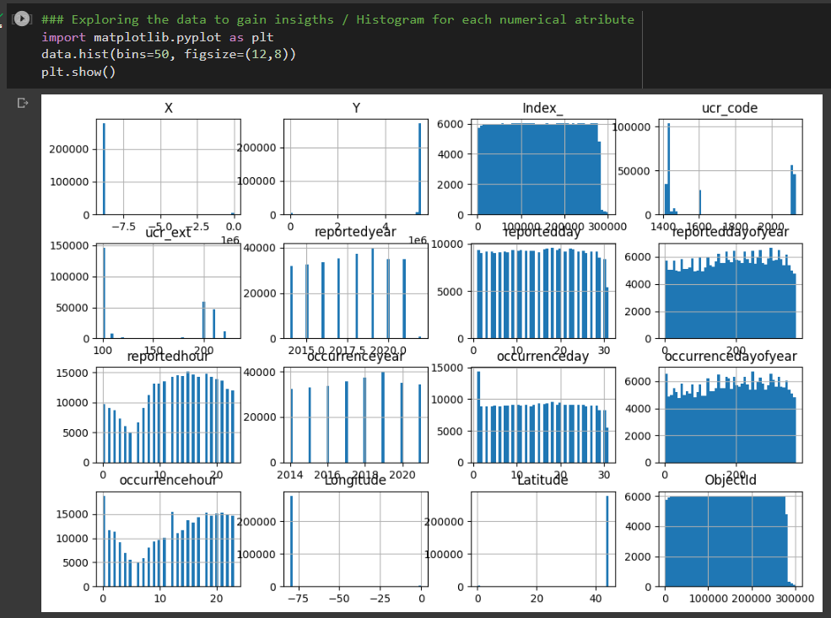
3. Explore and visualize the data to gain insights
METHODOLOGY

Slide 18
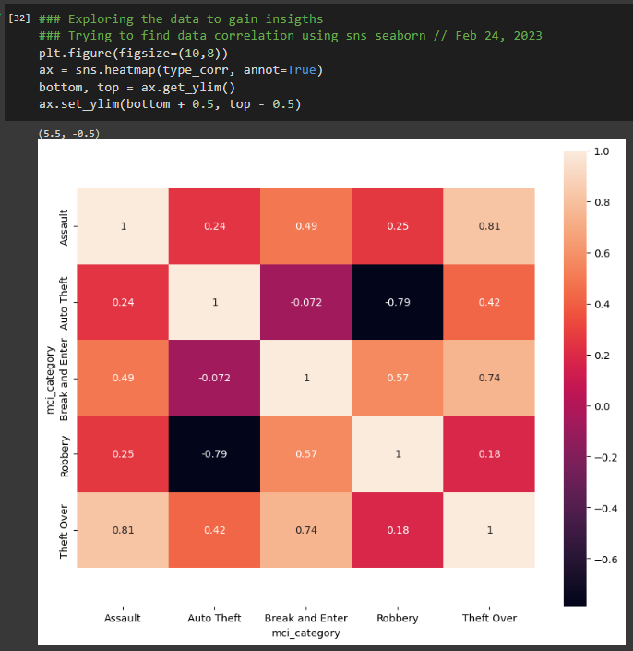
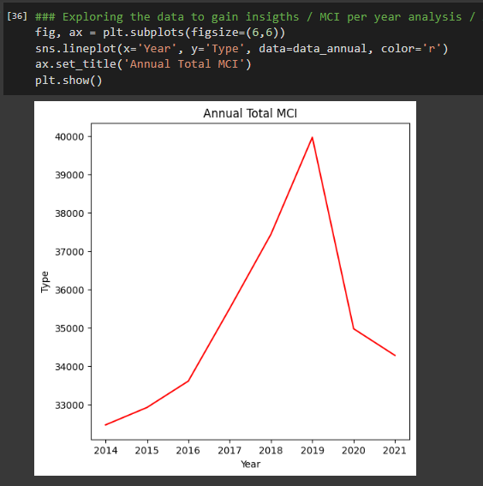
3. Explore and visualize the data to gain insights
METHODOLOGY

Slide 19
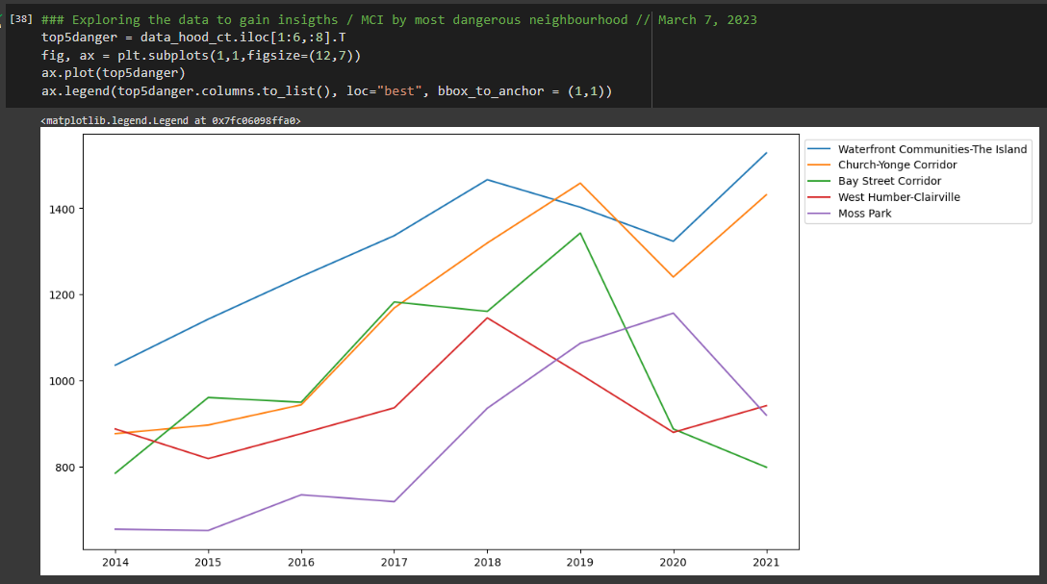
3. Explore and visualize the data to gain insights
METHODOLOGY

Slide 20
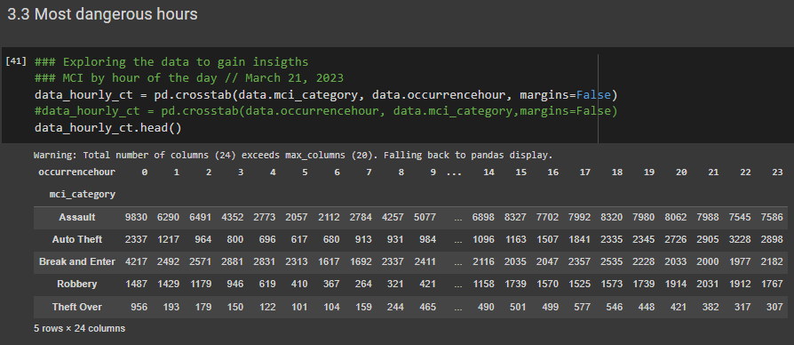
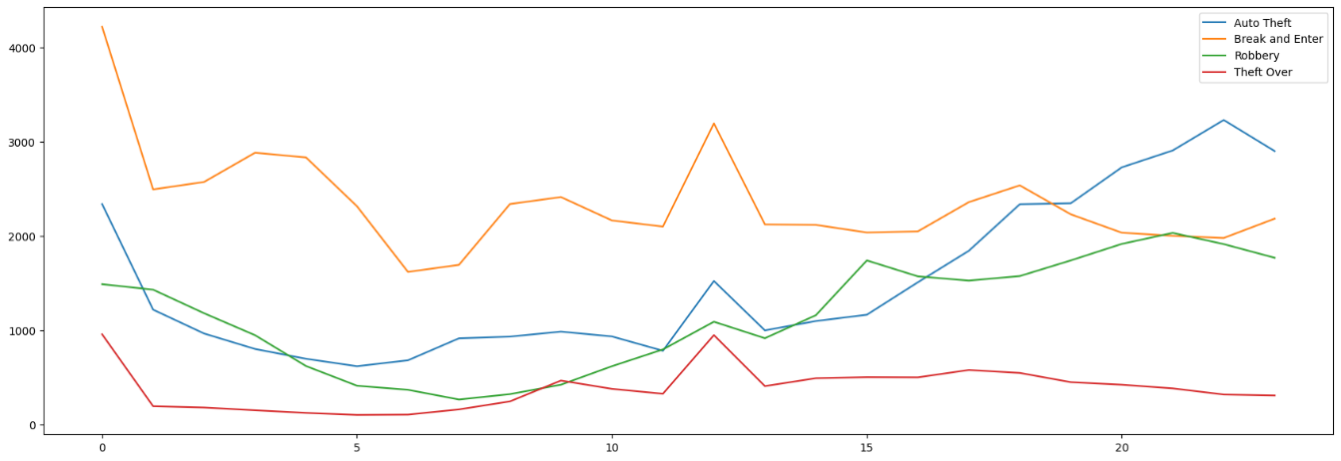
3. Explore and visualize the data to gain insights
METHODOLOGY

Slide 21
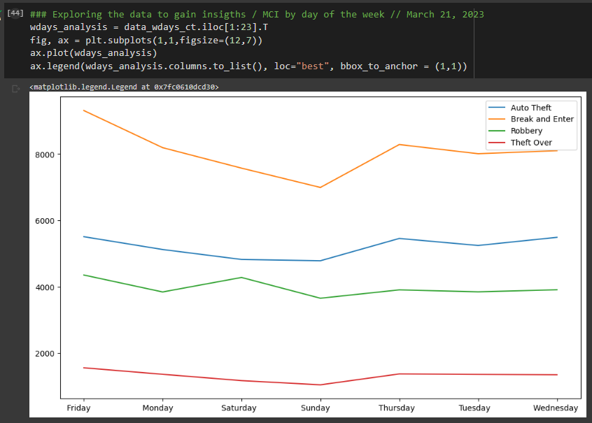
3. Explore and visualize the data to gain insights
METHODOLOGY

Slide 22
3. Explore and visualize the data to gain insights
METHODOLOGY

Slide 23
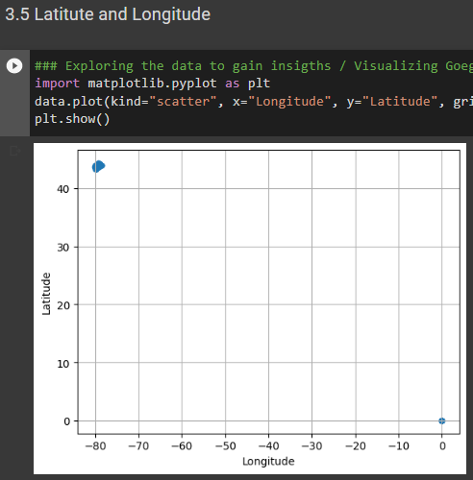
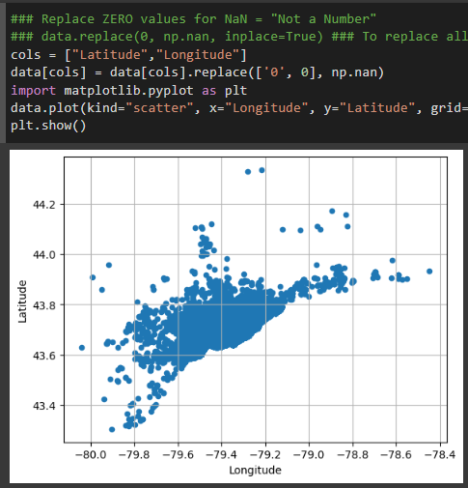
3. Explore and visualize the data to gain insights
METHODOLOGY
### Replace ZERO values for NaN = "Not a Number"
### data.replace(0, np.nan, inplace=True) ### To replace all the columns
cols = ["Latitude","Longitude"]
data[cols] = data[cols].replace(['0', 0], np.nan)

Slide 24

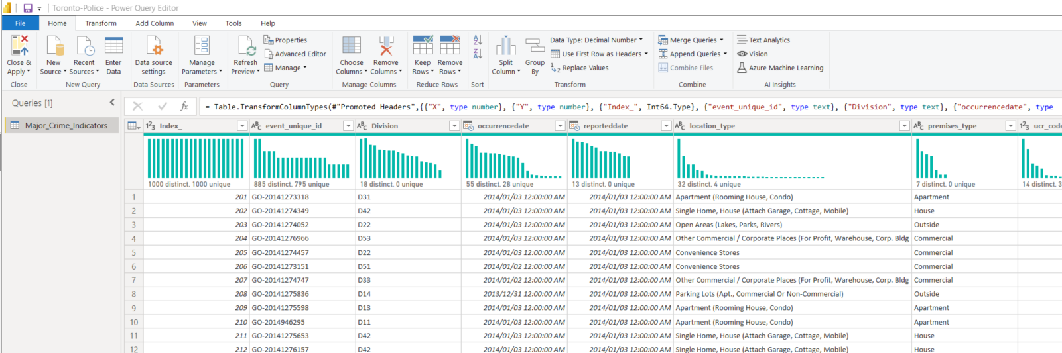
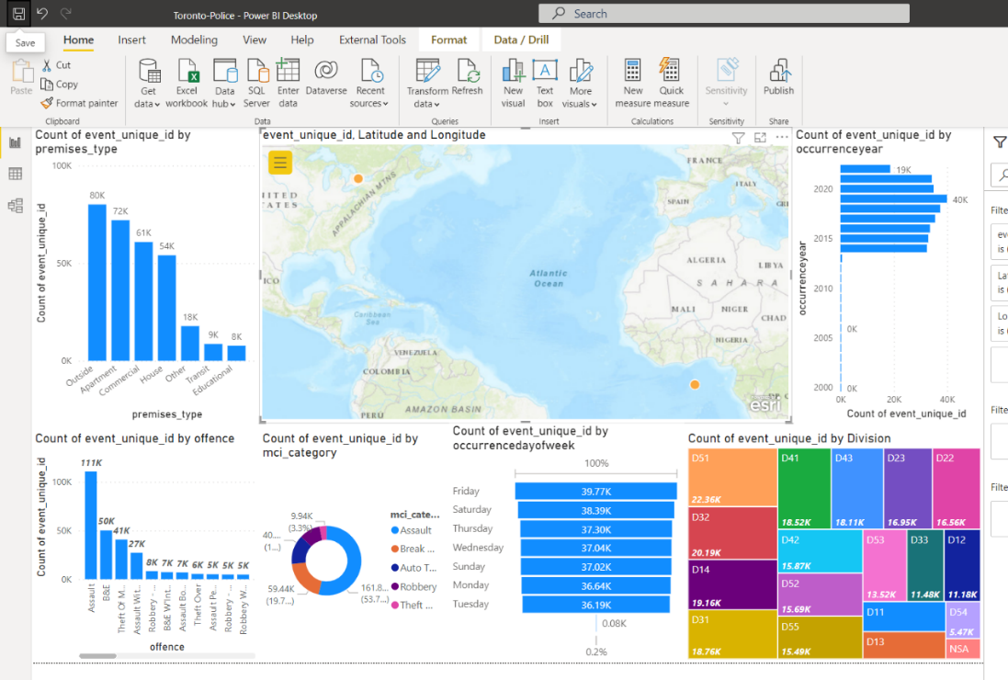
3. Explore and visualize the data to gain insights
METHODOLOGY
Microsoft
PowerBI
Additionally, we used a visualization tool (PowerBI) to explore, visualize and gain insights from the dataset. Easy, fast, and visual.

Slide 25
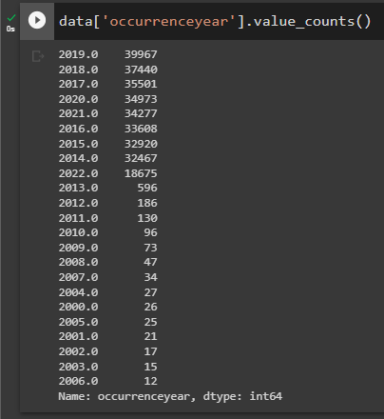

3. Explore and visualize the data to gain insights
METHODOLOGY
Microsoft
PowerBI

Slide 26
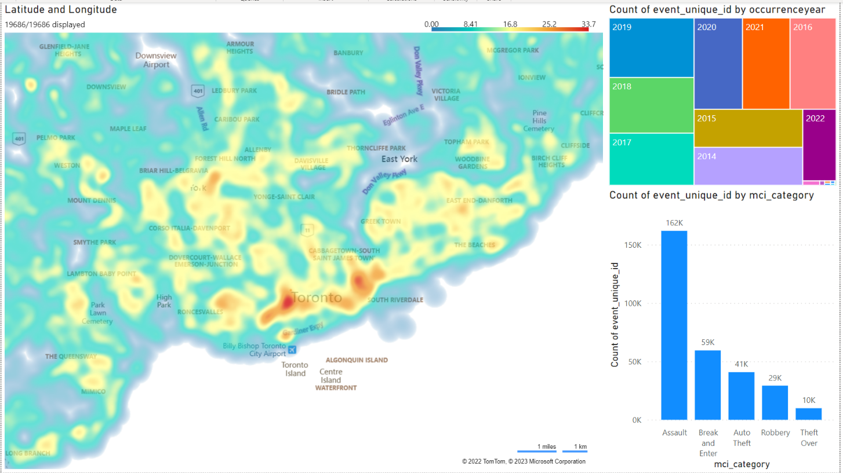
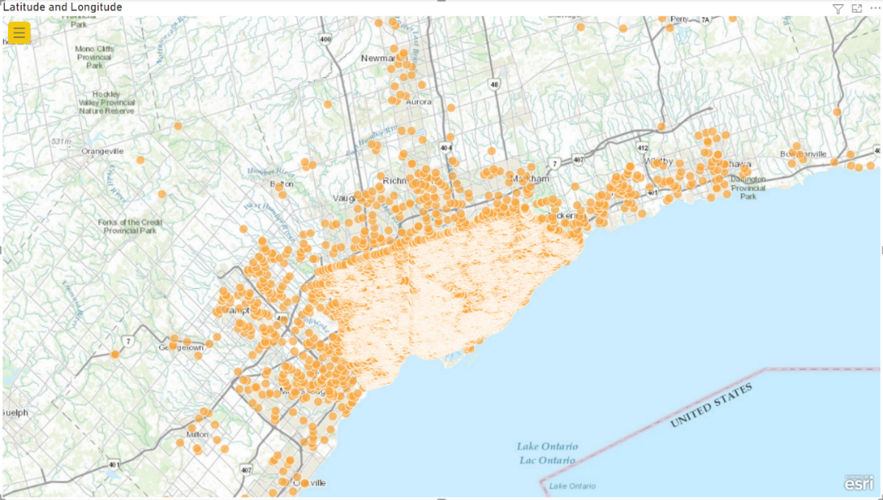
3. Explore and visualize the data to gain insights
METHODOLOGY
Microsoft
PowerBI

Slide 27

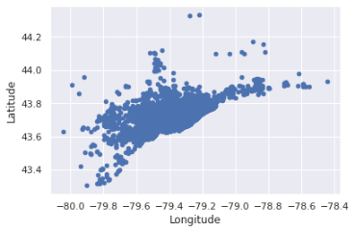
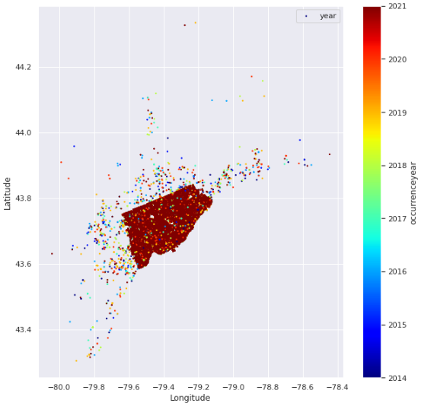
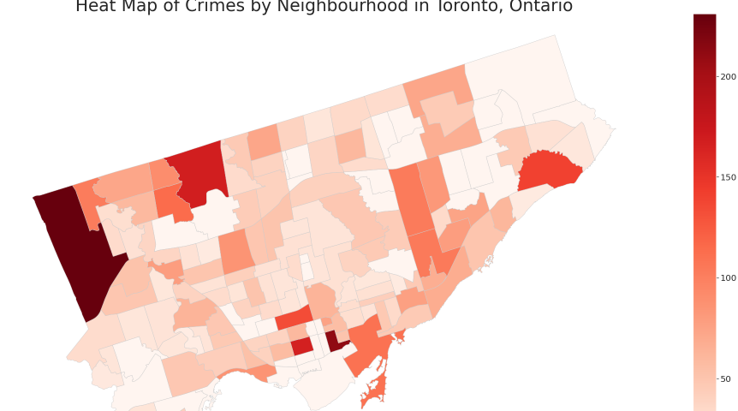
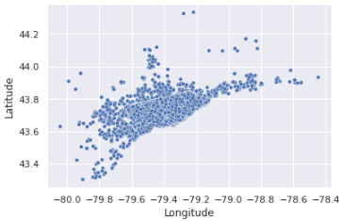
3. Explore and visualize the data to gain insights
METHODOLOGY
Google
Collab
Powerful data visualizations features
Using scatterplots, maps, and shape files…

Slide 28
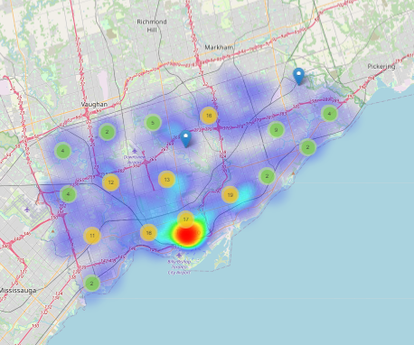
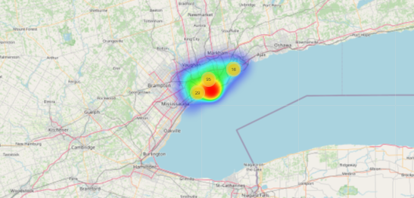
3. Explore and visualize the data to gain insights
METHODOLOGY
Google
Collab
And also more advanced resources like Folium with zoom features and etc.
https://python-visualization.github.io/folium/quickstart.html

Slide 29
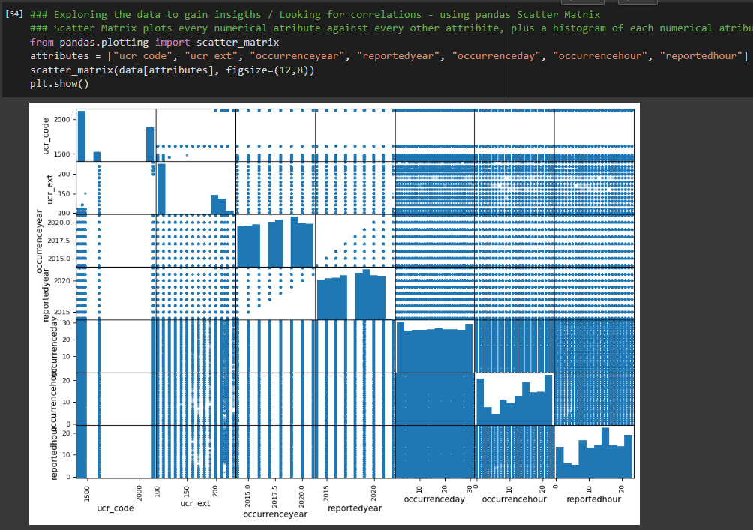
3. Explore and visualize the data to gain insights
METHODOLOGY

Slide 30

We need more data…

Slide 31
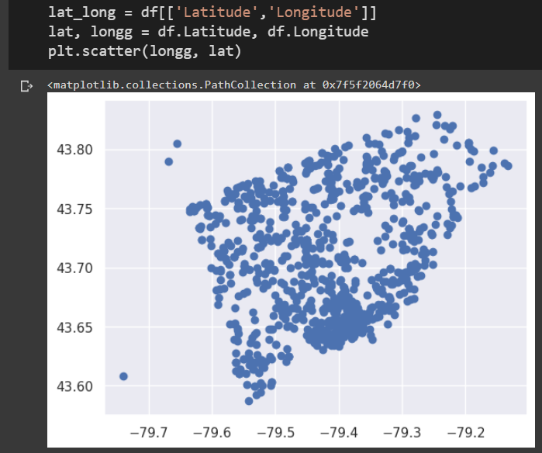
4. Prepare the data for the ML algorithm
METHODOLOGY
Plotting Latitude and Longitude values

Slide 32
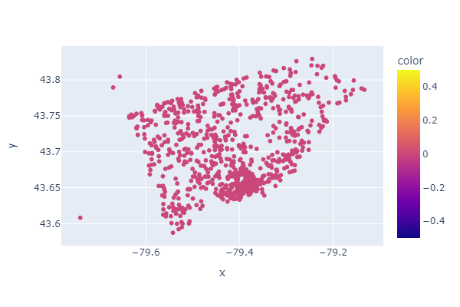
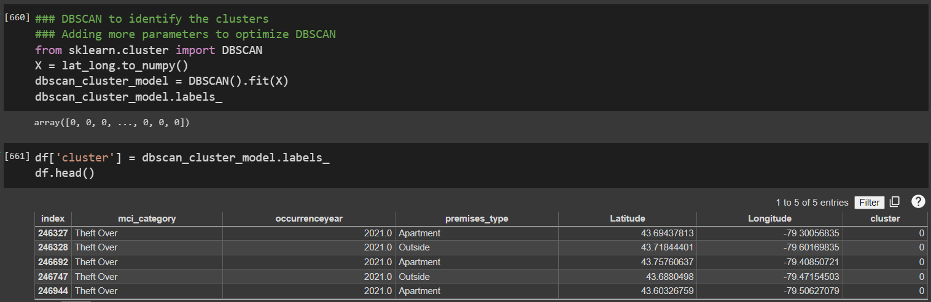
5. Select a model and train it
METHODOLOGY
DBSCAN using Latitude and Longitude features

Slide 33
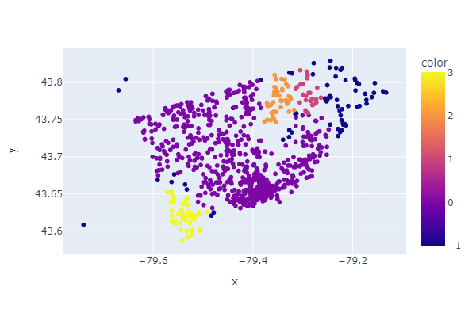
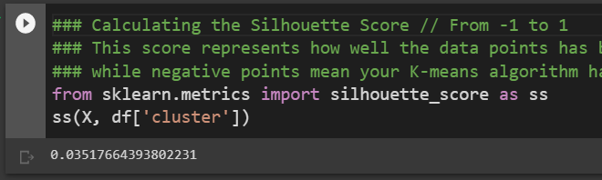
5. Select a model and train it
METHODOLOGY
DBSCAN using Latitude and Longitude features

Slide 34
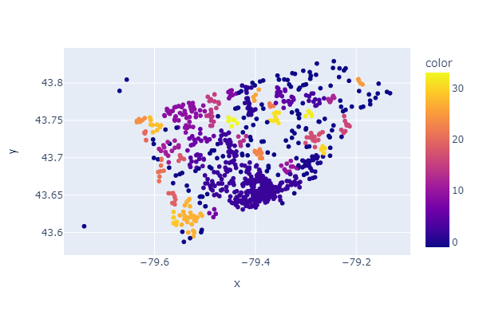
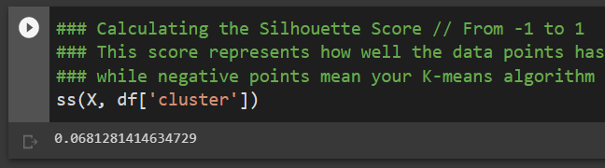
6. Fine-tune your model
METHODOLOGY
DBSCAN using Latitude and Longitude features
Several combinations for eps and min_samples

Slide 35
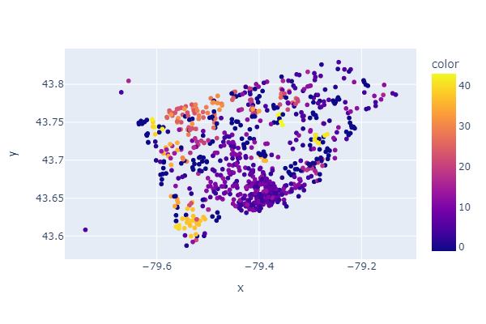
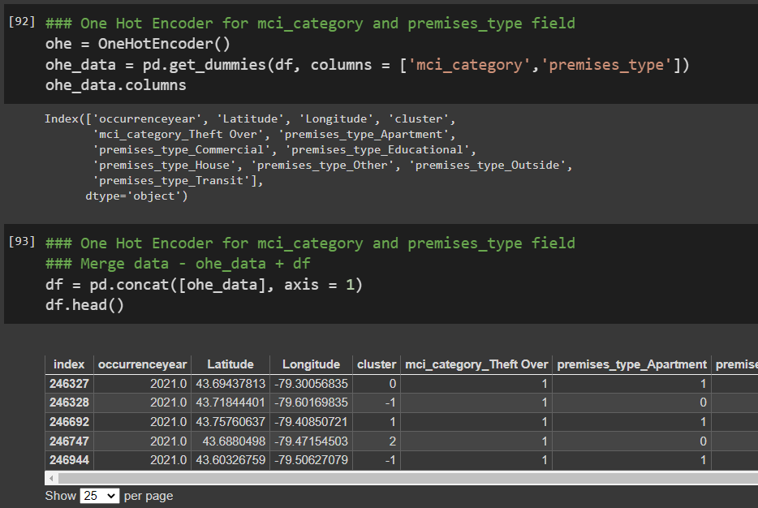
6. Fine-tune your model
METHODOLOGY
DBSCAN using Latitude and Longitude features
Adding new features (OHE > mci_category & premises)

Slide 36
6. Fine-tune your model
METHODOLOGY
Silhouette Analysis using k-means to find
the ideal # of clusters
For 3 clusters the AVG Silhouette Score = 0.6312005687664468 Next...
For 6 clusters the AVG Silhouette Score = 0.6242680845731877 Next...
For 9 clusters the AVG Silhouette Score = 0.6219071008417552 Next...
For 12 clusters the AVG Silhouette Score = 0.6039122205183359 Next...
For 15 clusters the AVG Silhouette Score = 0.6502589731015673 Next...
For 18 clusters the AVG Silhouette Score = 0.694167706152834 Next...
For 21 clusters the AVG Silhouette Score = 0.7511084295804148 Next...
For 24 clusters the AVG Silhouette Score = 0.7810515666285528 Next...
For 27 clusters the AVG Silhouette Score = 0.823988304607556 Next...
For 30 clusters the AVG Silhouette Score = 0.8435800167012812 Next...
For 33 clusters the AVG Silhouette Score = 0.8571568601223338 Next...
For 36 clusters the AVG Silhouette Score = 0.8761368349346094 Next...
For 39 clusters the AVG Silhouette Score = 0.8956240293835462 Next...
For 42 clusters the AVG Silhouette Score = 0.9090275448838063 Next...
For 45 clusters the AVG Silhouette Score = 0.9224878434813757 Next...
For 48 clusters the AVG Silhouette Score = 0.9337492605790139 Next...
For 51 clusters the AVG Silhouette Score = 0.9430669405354508 Next...
For 54 clusters the AVG Silhouette Score = 0.9109089527785104 Next...
For 57 clusters the AVG Silhouette Score = 0.8847501953993314 Next...
For 60 clusters the AVG Silhouette Score = 0.859151251299482 Next...
For 63 clusters the AVG Silhouette Score = 0.8013646650548201 Next...
For 66 clusters the AVG Silhouette Score = 0.7511701226832084 Next...
For 69 clusters the AVG Silhouette Score = 0.7358522217798414 Next...
For 72 clusters the AVG Silhouette Score = 0.7271377592154833 Next...
For 75 clusters the AVG Silhouette Score = 0.7130372623601136 Next...
For 78 clusters the AVG Silhouette Score = 0.6836004200751056 Next...
For 81 clusters the AVG Silhouette Score = 0.6936645475506825 Next...
For 84 clusters the AVG Silhouette Score = 0.6629023565053651 Next...
For 87 clusters the AVG Silhouette Score = 0.6312766149553531 Next...
For 90 clusters the AVG Silhouette Score = 0.6521264511513082 Next...
For 93 clusters the AVG Silhouette Score = 0.6574746989205946 Next...
For 96 clusters the AVG Silhouette Score = 0.6453992305767153 Next...
For 99 clusters the AVG Silhouette Score = 0.6196287186575458 Next...

Slide 37
7. Conclusions
METHODOLOGY
Before you fine tune your model try to find relevant features for you data and expected results

Slide 38
Results and Model Performance
### Calculating the Silhouette Score // From -1 to 1
### This score represents how well the data points has been clustered, and scores above 0 are seen as good,
### while negative points mean your algorithm has put that data point in the wrong cluster.
3 tested scenarios:
DBSCAN
Silhouette score: N/A only 1 cluster
(2) DBSCAN with parameters
Silhouette score: 0.03517664393802231
(3) DBSCAN several times
Silhouette score: 0.0681281414634729
(4) DBSCAN added features // OneHotEncoder
Silhouette score: 0.8228147854082031
Why did we choose DBSCAN? Because we don’t want to define the number of clusters. We would like the algo to define it for us.

Slide 39

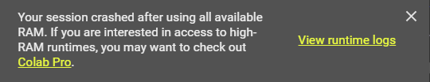
CHALLENGES
Challenges
Team communication and collaboration (e-mail, WhatsApp, etc.)
Share the code with the whole team and collaborate (GitHub)
Make sure you know the data you are working on. Do not make wrong assumptions about your data – occurrence-date – occurrence-year
Working with date fields is always challenging – transformation, calculation, etc.
Time consuming process (CPU/GPU time)

Slide 40

CHALLENGES
Really great tool and easy to install
Documentation is good with good code samples (several links are broken)
Speed up the DS analysis and process, so you can dedicate your time to other tasks, like presenting the data, results, etc.
https://github.com/caiogasparine/SCS_3253_061-Machine-Learning/blob/main/Toronto_Police_MCI_with_pyCaret.ipynb

Slide 41

LESSONS LEARNED
Lessons Learned (1)
Tools are important, but team collaboration and team interaction are key components in the analysis and scenario validation.
Reproducibility – only if we keep the data cleaning process documented in the code will be possible to reproduce exactly the same result utilizing the original dataset. Avoid manual data cleaning directly to the dataset.
Quick reading – The visualization tool (PowerBI) allowed us to do a “quick reading” on the available data, generating quick and easy insights (simple ones).
Correlation – Get rid of highly correlated features because they don’t add any value to your model
Data cleaning – Be prepared for the data cleaning process. It is not a process but an iteration with several cycles.
Code – Be familiar with your IDE (e.g., Collab) and use its features. It will make your life much easier (e.g., Sections and Table of contents to organize the code)

Slide 42
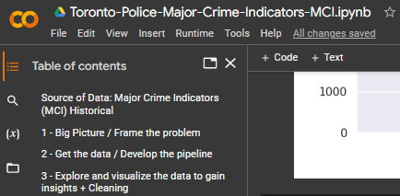
LESSONS LEARNED
Lessons Learned (2)
New best friends – “Stack Overflow” and “Google”
Table of contents – Use it to help you navigate in your code. It will be very helpful when your code grows.
Clear problem – Have a clear problem defined before you start working on your data, otherwise, you will be moving in circles.
Data cleansing – The earlier - in the process - you clear your dataset the better will be your vision for the important data…
Organize your code – Using sections will help you a lot when moving through your code…

Slide 43
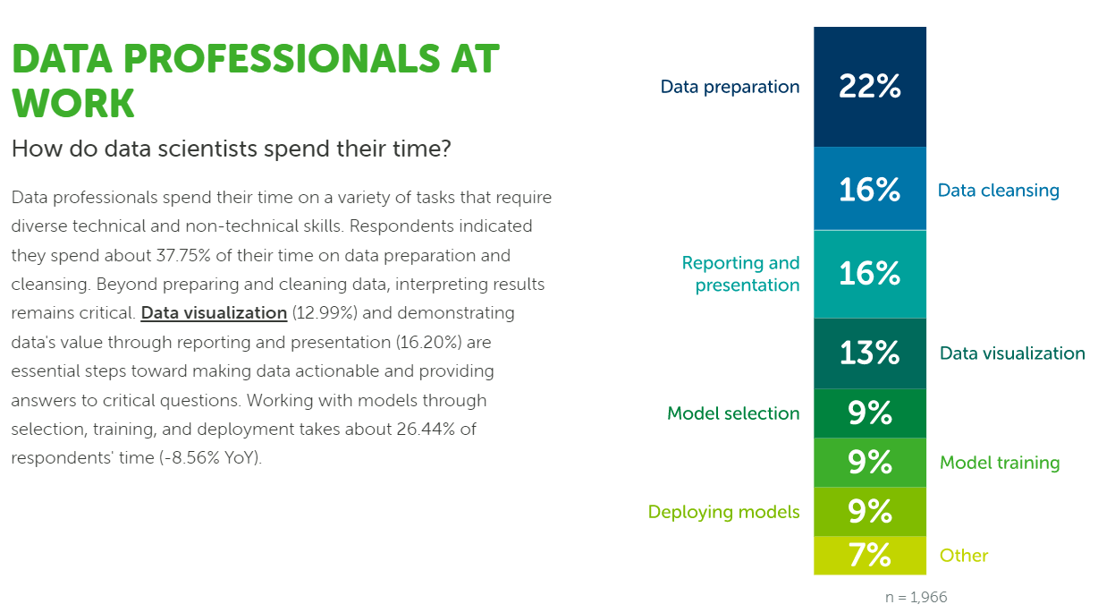
67%
LESSONS LEARNED
https://www.anaconda.com/state-of-data-science-report-2022

Slide 44







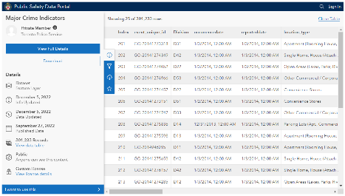
Enterprise Solution Architecture
S O U R C E S
I N G E S T
S T O R E
P R O C E S S
V I Z
Storage Account
SQL Database
Azure Machine Learning
Power BI
Data Factory
.CSV file
https://data.torontopolice.on.ca/pages/major-crime-indicators

Slide 45



Team Members
Illidan Yuan
www.linkedin
yilan_Illdian@hotmail.com
Caio Gasparine
IT Project Manager
Data & Analytics
https://www.linkedin.com/in/caiogasparine/
caiogasparine@gmail.com
Olivier Sangam
Electrical Designer
https://www.linkedin.com/in/olivier-mawaba-sangam-46a973108/
mawoliv@gmail.com
Fábio Queiroz
Sr. Data Engineer
https://www.linkedin.com/in/fabiomsq/
fabio.maia82@gmail.com

Slide 46








Tools we used…
Google Collab
GitHub
Microsoft PowerBI
Arc GIS
Python
Microsoft Azure

Slide 47

References
Géron, Aurélien 2022, Hands-On Machine Learning with Scikit-Learn, Keras, and TensorFlow: Concepts, Tools, and Techniques to Build Intelligent Systems, 3rd Edition, O'Reilly Media.
Toronto Police Service, https://data.torontopolice.on.ca/
Toronto Police Service, Public Safety Data Portal, February 2023, MCI documentation, https://data.torontopolice.on.ca/datasets/TorontoPS::major-crime-indicators-1/about
City of Toronto, Open data, Neighbourhoods, https://open.toronto.ca/dataset/neighbourhoods/
Mukund Vemuri 2019, Create a geographic heat map of the City of Toronto in Python, https://medium.com/@m_vemuri/create-a-geographic-heat-map-of-the-city-of-toronto-in-python-cd2ae0f8be55
Blob Storage, https://learn.microsoft.com/en-us/azure/storage/blobs/storage-blobs-introduction
Data Factory, https://learn.microsoft.com/en-us/azure/data-factory/
Machine Learning, https://learn.microsoft.com/en-us/azure/machine-learning/
Power BI, https://learn.microsoft.com/en-us/power-bi/fundamentals/videos
Azure icons, https://learn.microsoft.com/en-us/azure/architecture/icons/
* - references consulted between January 24, 2023, and April 6, 2023.

Slide 48
References (2)
Anaconda website, 2023, https://www.anaconda.com/state-of-data-science-report-2022
Jiri Stodulka 2023, Toronto Crime and Folium, website, https://www.jiristodulka.com/post/toronto-crime/
Folium, QuickStart, website, 2023, https://python-visualization.github.io/folium/quickstart.html
Pycaret, GitHub, 2023, https://github.com/pycaret/pycaret/blob/master/tutorials/Tutorial%20-%20Clustering.ipynb
Statistics Canada, UCR Code Uniform Crime Reporting Survey (UCR), website, 2023, https://www23.statcan.gc.ca/imdb/p2SV.pl?Function=getSurvey&SDDS=3302
* - references consulted between January 24, 2023, and April 6, 2023.

Slide 49

Thank you! ;-)
SCS 3253-061 – Machine Learning
Instructor: Saeid Abolfazli
Team members:
Caio Gasparine | Fábio Queiroz | Olivier Sangam | Illidan Yuan
https://github.com/caiogasparine/SCS_3253_061-Machine-Learning

